Slide 1
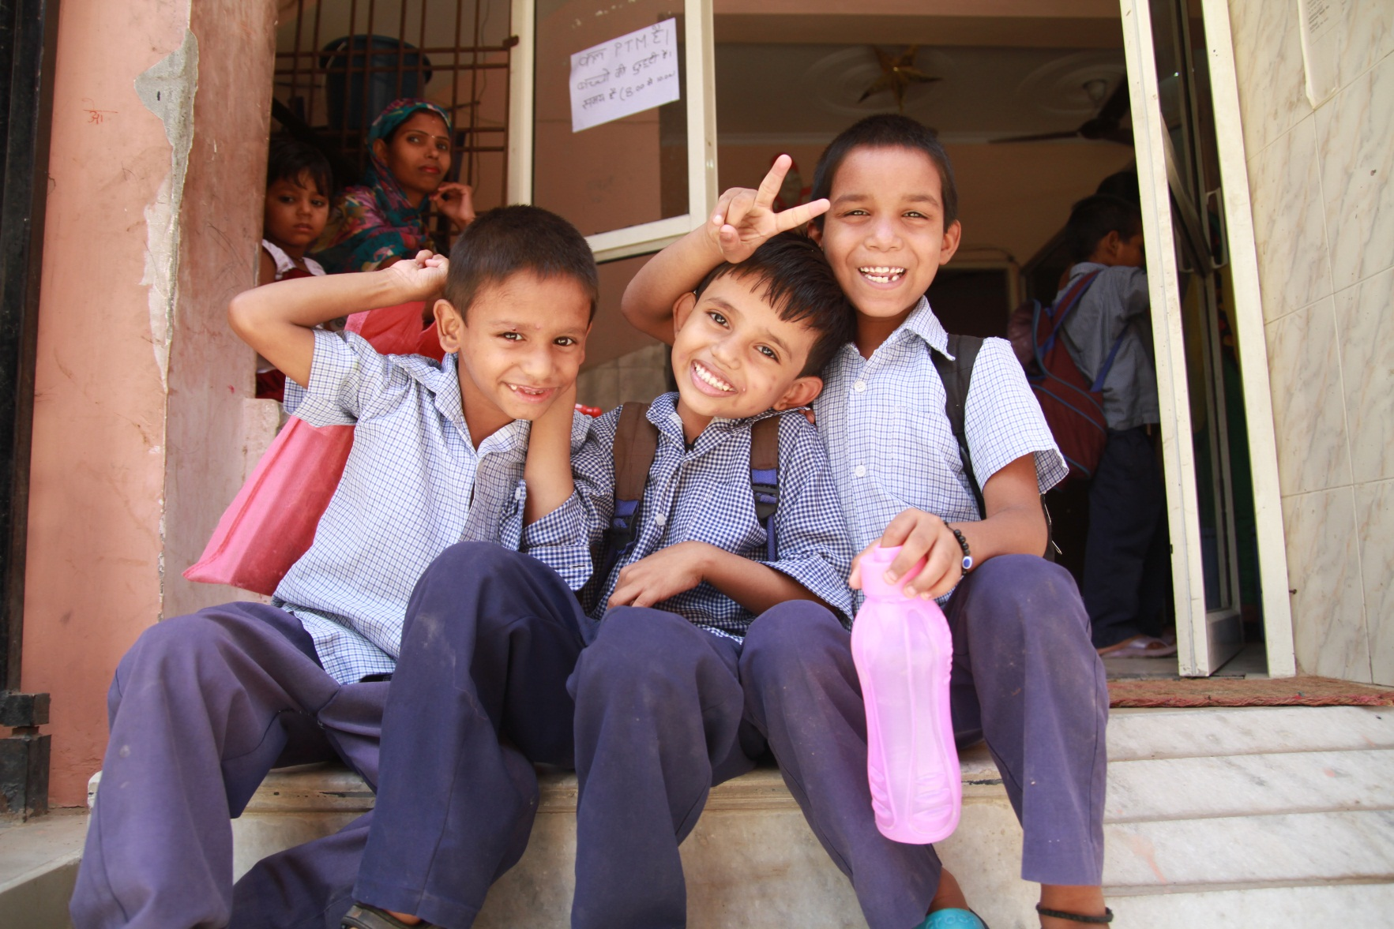

Slide 2
Who we are :
Mera Parivar : Non-Profit, Charitable NGO (registered under FCRA Act of Ministry of Home Affairs) + Income Tax Exemption.
Created in 2006 → 10 years of assistance for disadvantaged community (children, youth, women) in Gurgaon.
Areas of work : education, knowledge, vocational training, advocacy.

Slide 3
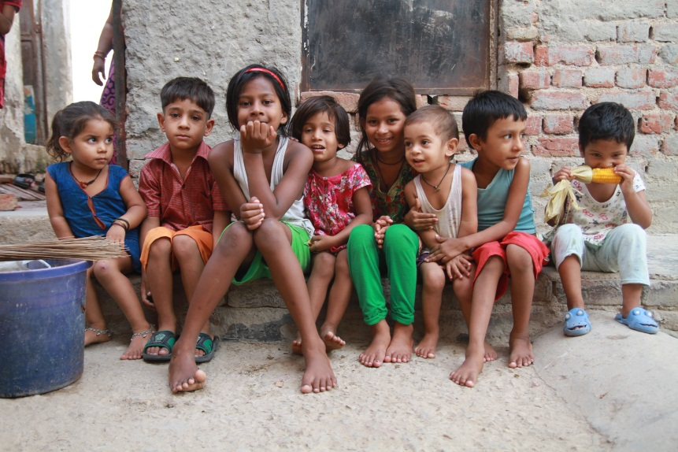
Our Vision
We believe in everyone’s "right to life with dignity". We want to create an equal, just, and sustainable world empowering the poor to demand respect for their basic rights, to become active citizens and to make job markets accessible for disadvantaged people.

Slide 4
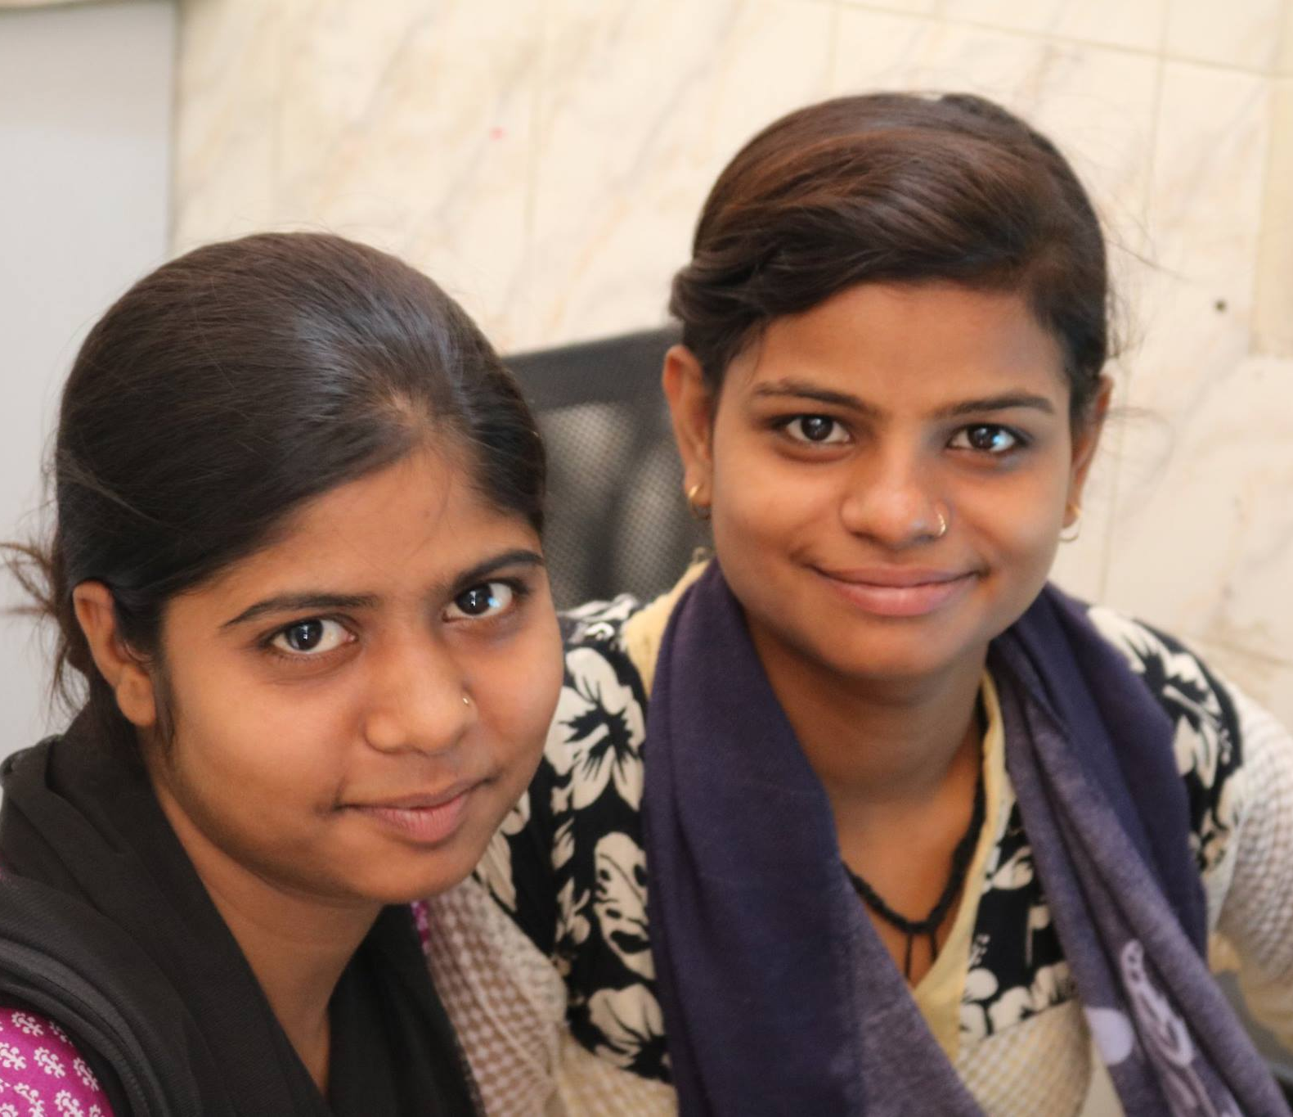
Our Mission
Mera Parivar is committed to work towards empowerment and uplifting communities, children, women and youths. Through education, building professional skills and personal development, Mera Parivar wants to help the disadvantaged people to realize their full potential and achieve self-reliance so as to give them the power to control their own lives and future.

Slide 5
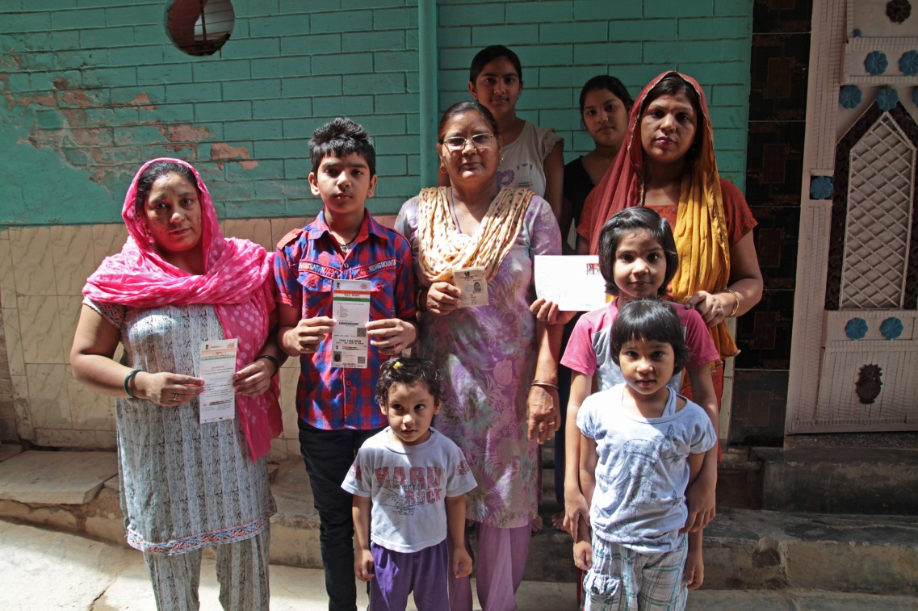
Our Core Values
1 : Transparency and good governance
2 : Do not harm principle
3 : Empowerment of communities
4 : Equity and fairness
5 : Impartiality in our actions
6 : Accountability to our partners, donors and to civil society

Slide 6
Our organization

Slide 7
Our programs
4 mains programs :
Children Education
Youth training
Women empowerment
Advocacy and community assistance

Slide 8
Education for Children
Care and nurturing for children nursery, LKG and UKG.
Informal education to those children who remain outside formal educational systems. English, Hindi and Mathematics classes so that children can be at par with the required standard for public schools.
Raise awareness amongst families on the importance of education and prevent school dropout (especially for girls).
Scholarships (free tuition) for poorer children to attend school

Slide 9
Mera Parivar education program in 2015

Slide 10
Nutritional support everyday for 300 children

Slide 11
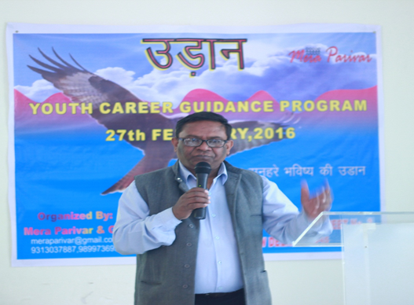
Youth : vocational and skills training
Comprehensive training including Computer basics, Retail Management, Office management, Career Guidance, Personality Development, Interview facing and English classes.
Job placement and vocational trainings

Slide 12
In 2015… 70% of youth placed in companies!

Slide 13
Women Empowerment
Increasing women's leadership and participation in their communities (self-empowerment programs)
Beauty parlor and stitching training to achieve financial independence for women and secure a job
Adult literacy classes for women

Slide 14
200 women beneficiary in 2015

Slide 15
Advocacy & Community Assistance
Give voice to the underprivileged community
Information and awareness about schemes and entitlements available for the disadvantaged and less privileged
Legal Awareness and assistance
Health & Hygiene camps and interventions

Slide 16
Community assistance in 2015

Slide 17
Advocacy

Slide 18
How to get involved ?
Become a PARTNER
- Visit us
- Help us with training
Employees’ mentorship
program with youth
Become a DONOR
- Donations in kind or financial donations
- Tax Exemptions Possible

Slide 19
Thank you !
We hope to hear back from you soon !
Contact :
meraparivar@gmail.com
Tel : 7838594404
www.meraparivar.org

